Slide 1

Stock price prediction by using ML algorithms
(symbol: VOO)
Jin He 何建進
Photo by @riverhetw

Slide 2
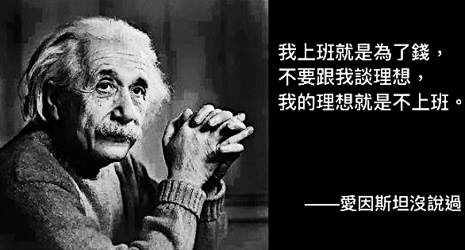
Motivation
1

Slide 3
Overview
STOCK SELECTION
BASIC MODEL
BUILDING
BACKTESTING
DATA FROM YFINANCE
TRAINING MODEL STRUCTURING
BAD
PERFORMANCE
GOOD
FEATURE
MANIPULATION
MODEL TUNING
RESULT & IMPLEMENT
DATA PREPARATION
ML ALGORITHMS
BACKTESTING
2

Slide 4
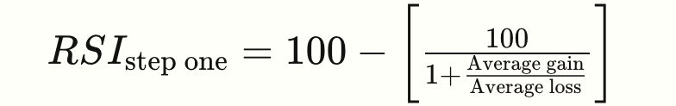
Features
OHLC + VOLUME
[x1,x2,x3,…] days MA + TREND
TREND: up/down percentage during a period, e.g. only 3 up over the past 10 days scores 3/10
[x1,x2,x3,…] days RSI, >50 means gaining more
Deterministic features:
time series with 1, 2, 3,…to len(); or squared time series with 1², 2², 3²,…to len()²
CPI / FED FUND RATES (optional due to time delay almost a month)
3

Slide 5

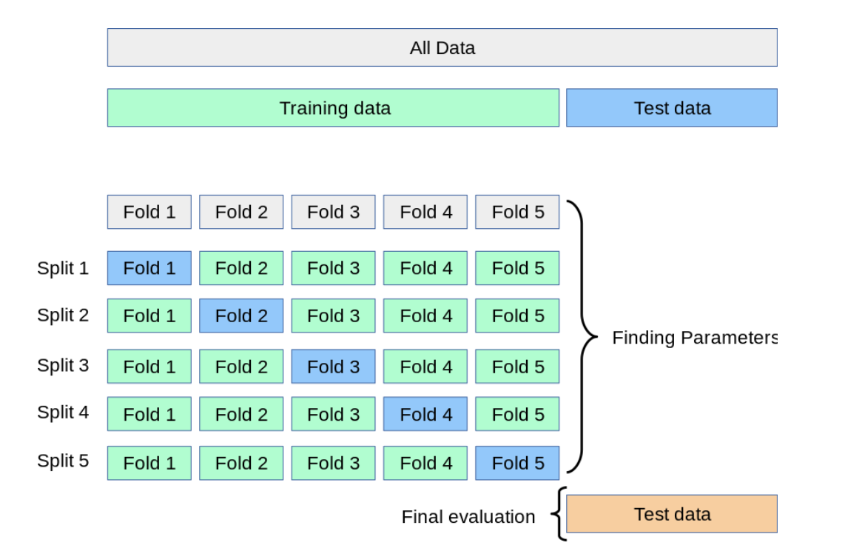
Basic model building
Using Sklearn cross_val_score, CV groups = 5
4

Slide 6
Training algorithm
Processed DATA input
Setup training time frame, e.g. from 1990 to 2021
Initial DATA
Iteration 1
Training DATA, 1~1000th records, N=1000
Testing DATA 1001~1250th records,
Model training
False
True
Calculate cumulated
Precision scores
N > len()
Model predict +
Precision scores
N+250
起始值使用前四年資料訓練, 預測第五年
往後迭代累加一年重新訓練, 預測後一年
使用累計準確率評估模型表現
Iteration 2
Training DATA, 1~1250th records
Testing DATA 1251~1500th records
….Iteration 3
5

Slide 7

Results
6

Slide 8
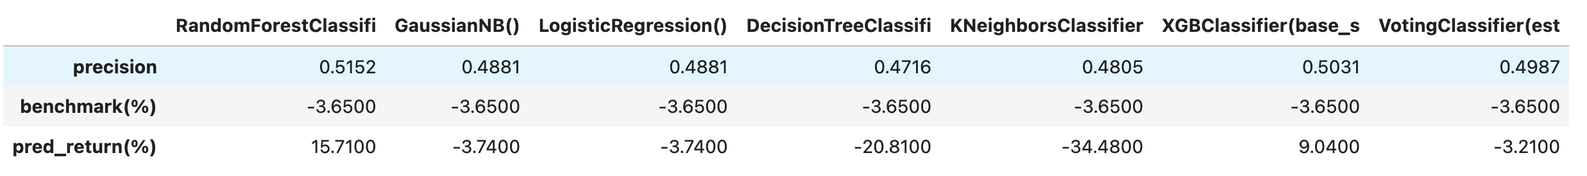
Backtesting
Model training data from 1990-01-01 ~ 2021-12-31
VOO backtesting period: 2022-01-01 ~ 2023-09-05
7

Slide 9
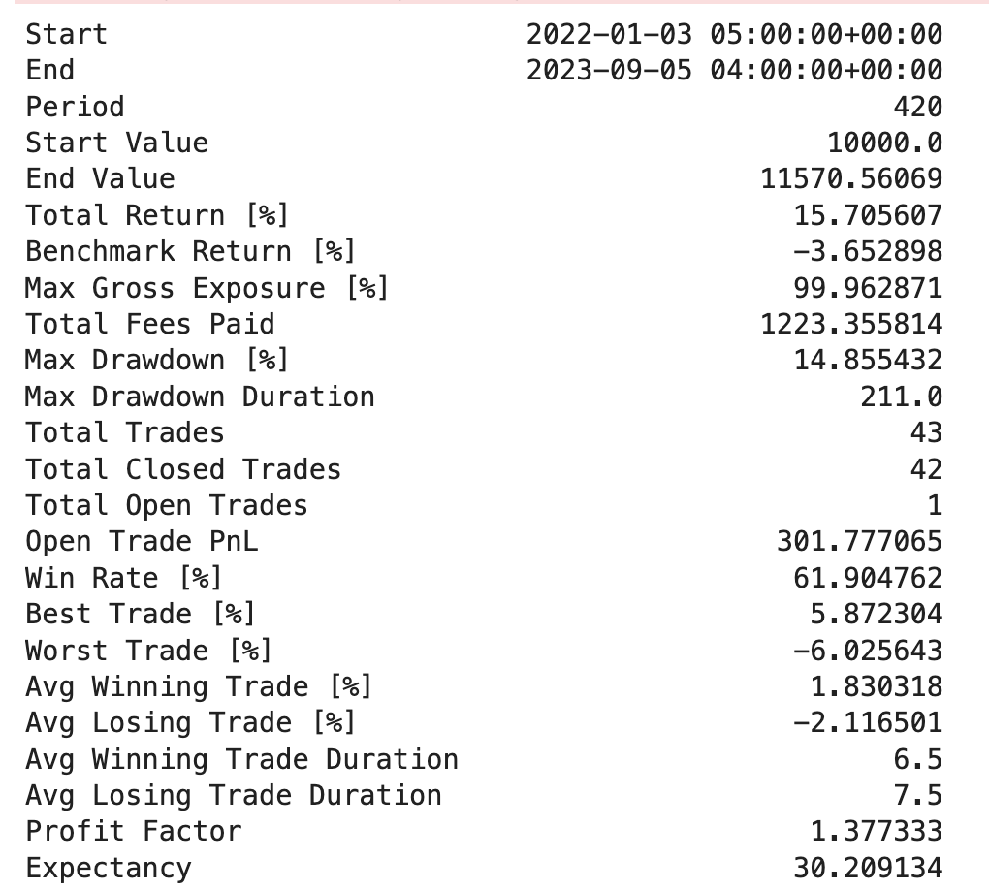
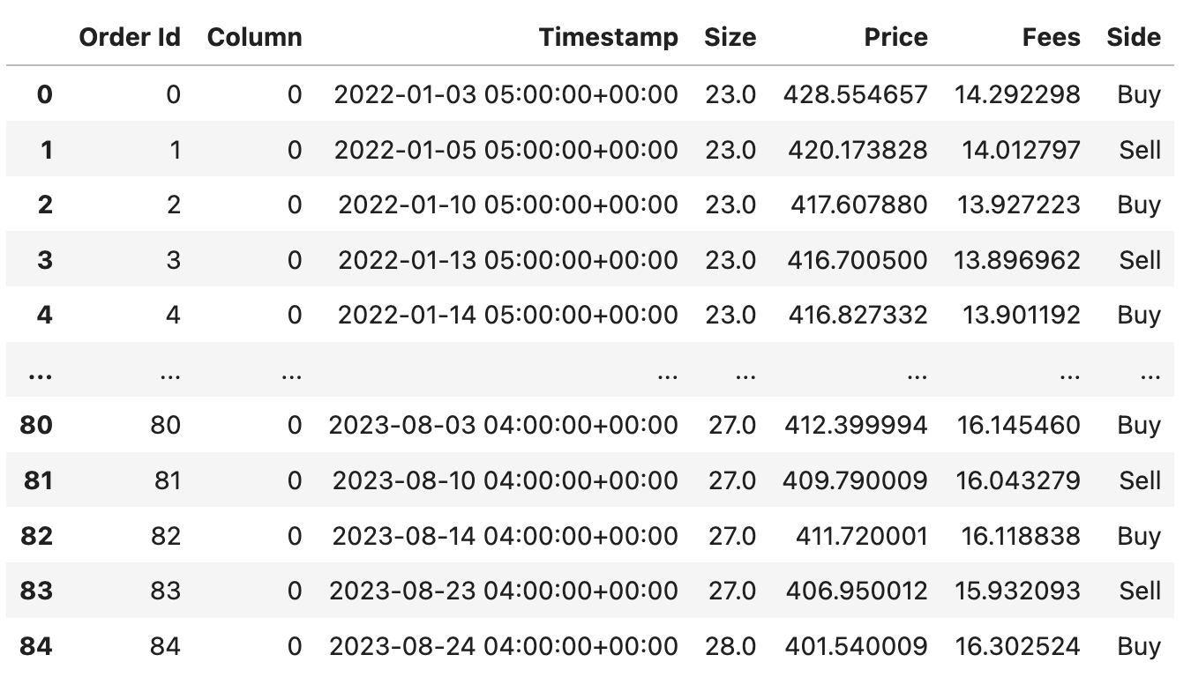
Performance
Summary
Trading records
8

Slide 10
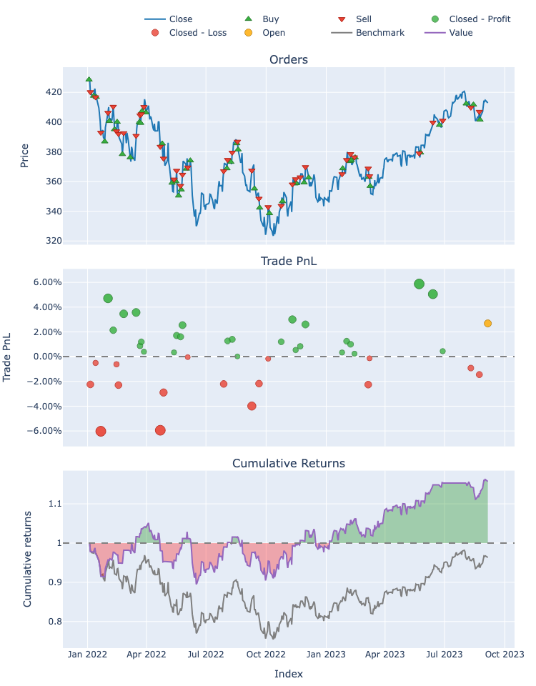
9

Slide 11
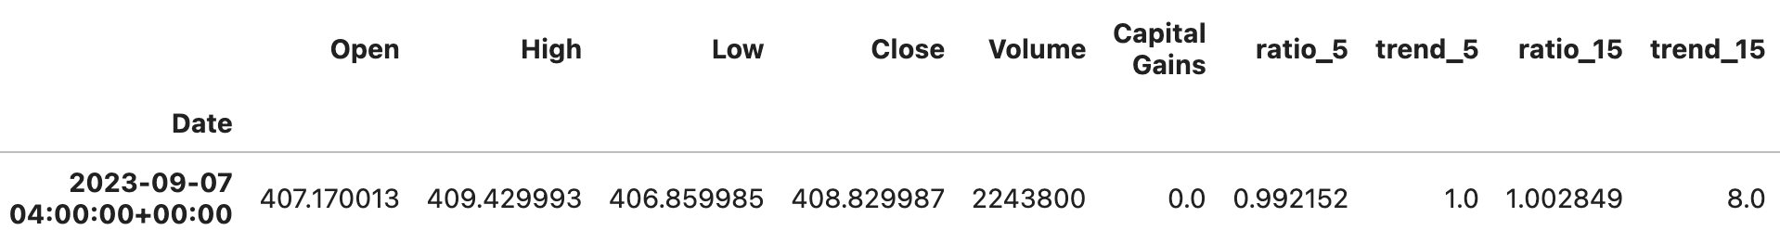
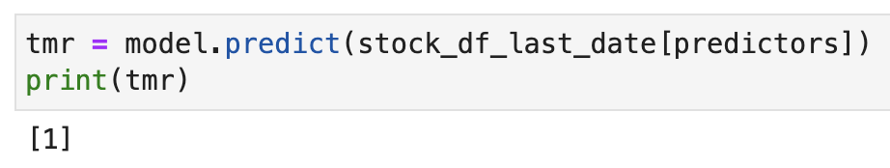
Predict if VOO will go up on 9/8
Input:
9/7 VOO DATA
Output:
If 9/8 will go up?
(基金投資有賺有賠 投資人申購前請詳閱基金公開說明書)
10

Slide 12
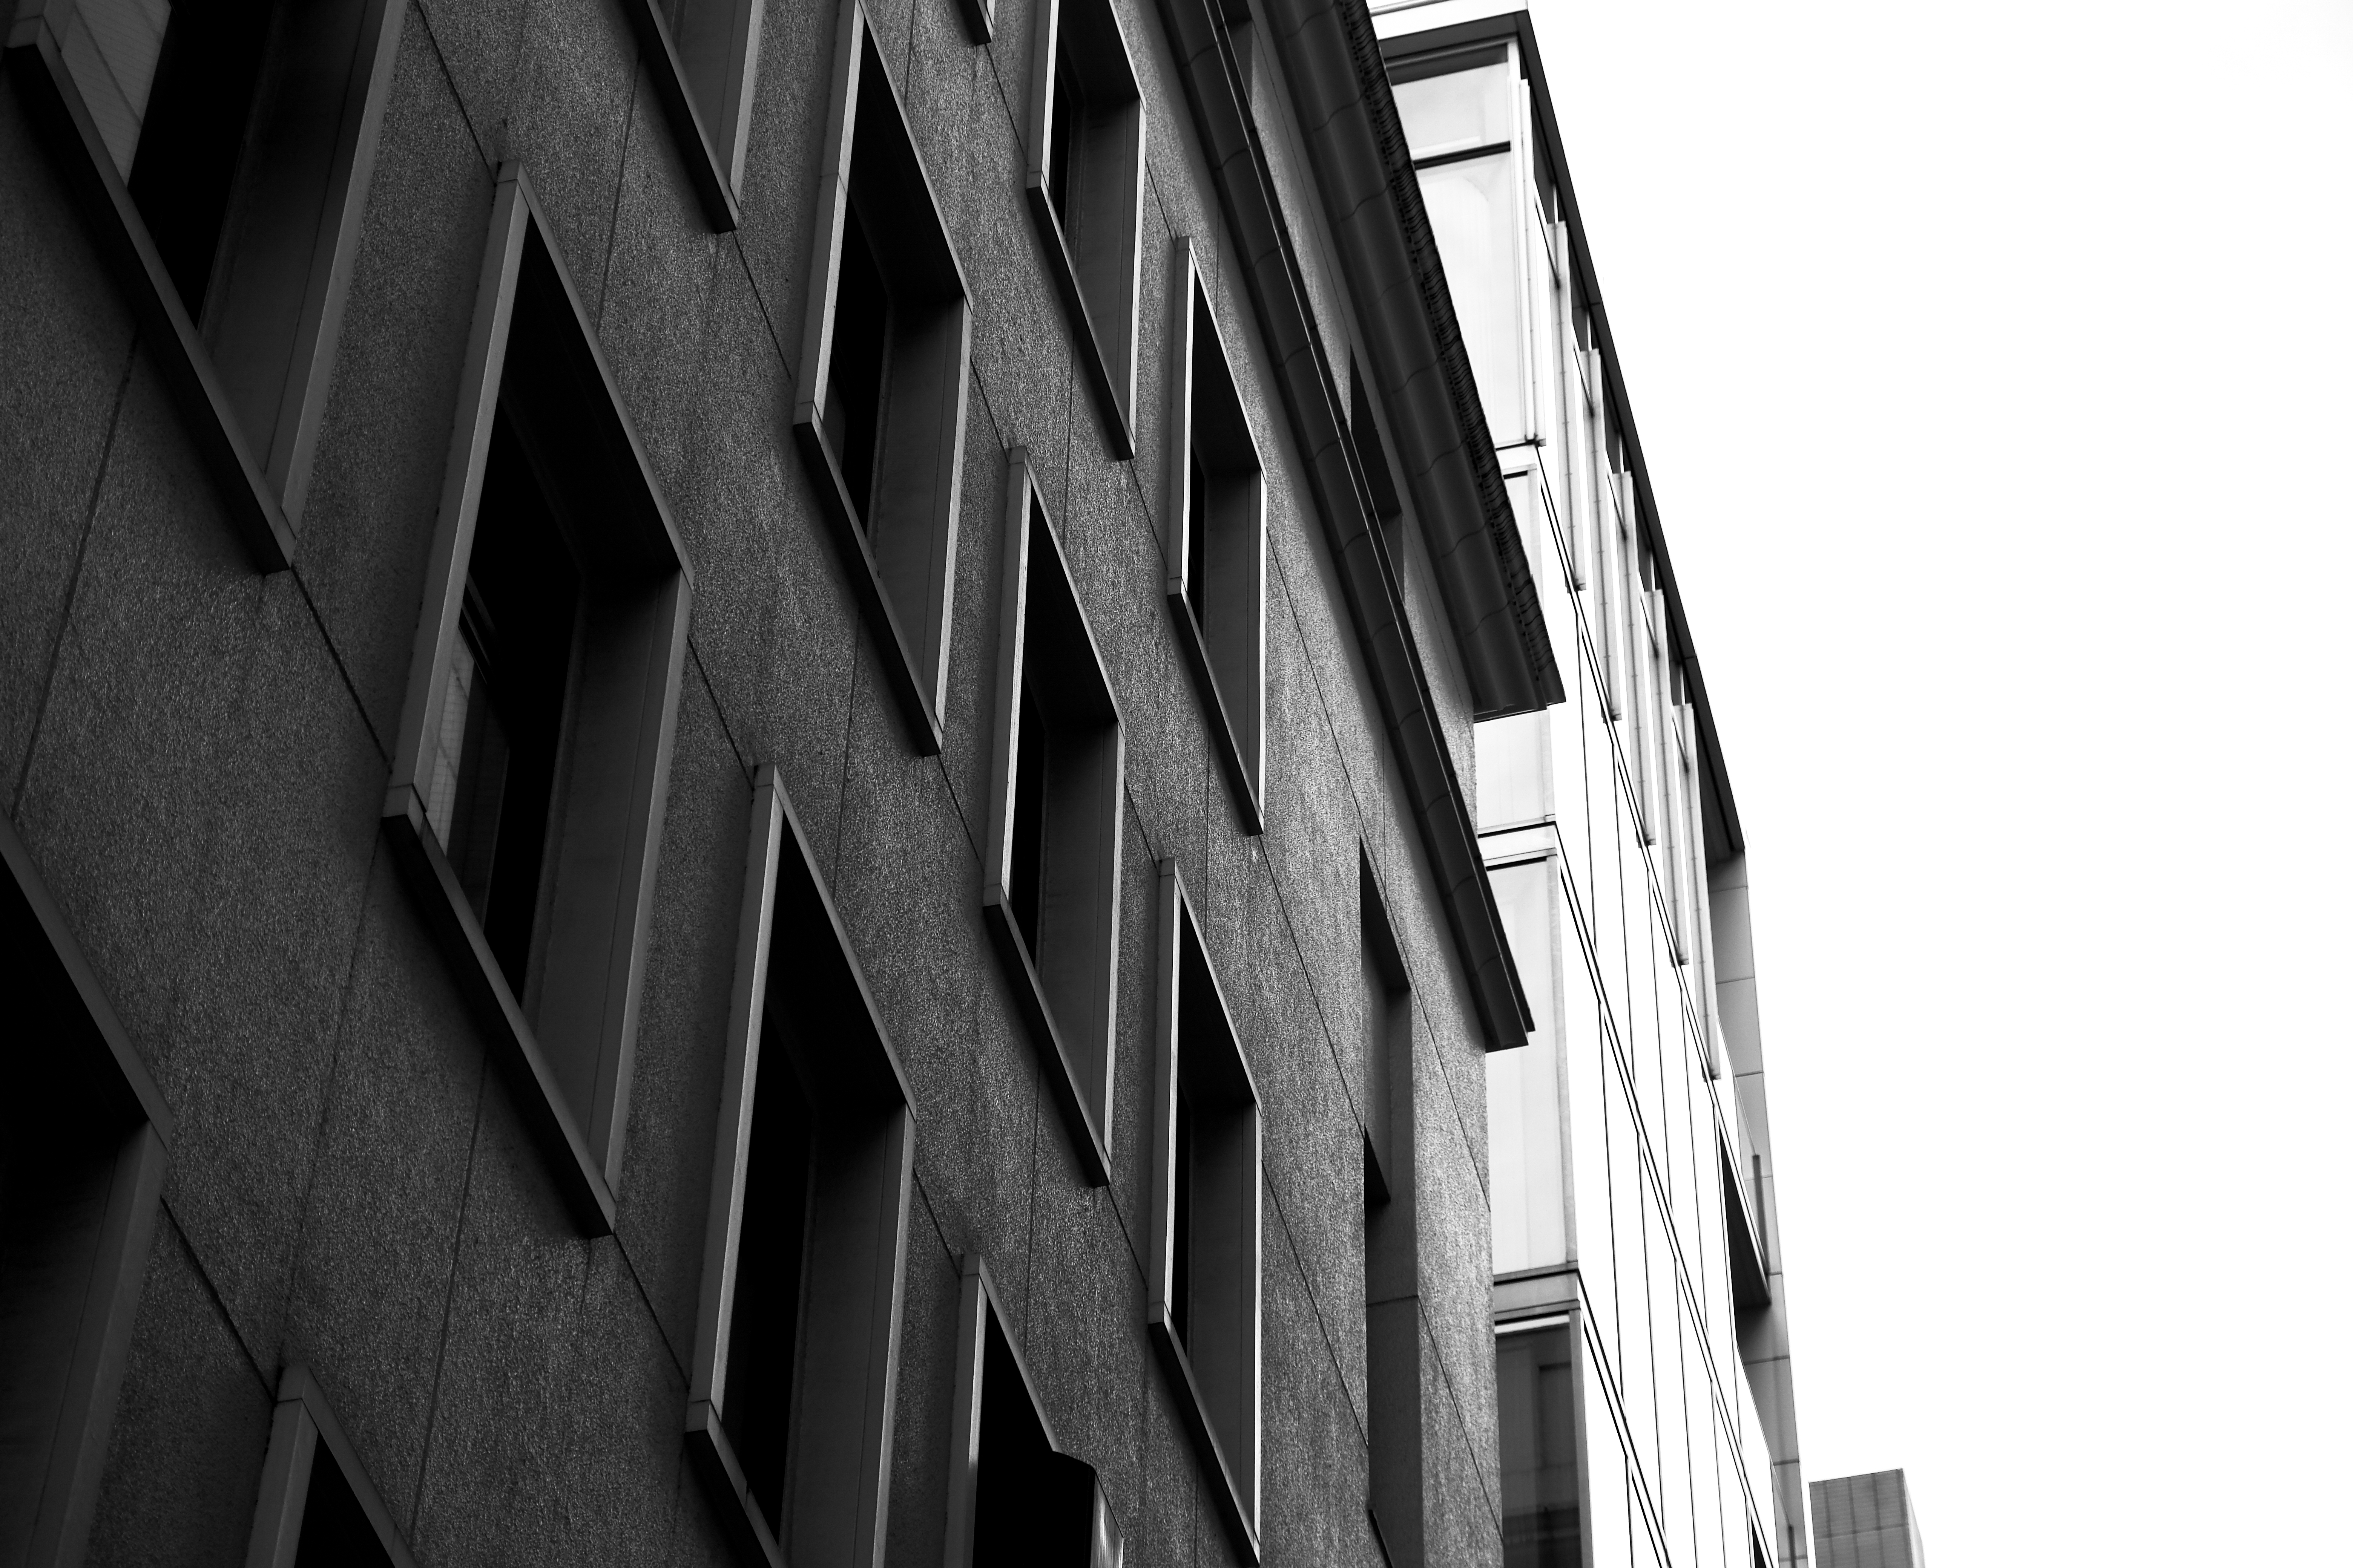
Thanks for listening
Photo by @riverhetw

